Slide 1
Introduction to Microsoft SQL Server
Lecturer: Ngo Huy Bien
Software Engineering Department
Faculty of Information Technology
VNUHCM - University of Science
Ho Chi Minh City, Vietnam
nhbien@fit.hcmus.edu.vn

Slide 2

Objectives

Slide 3

Contents

Slide 4

References
Adam Jorgensen et al. (2012). Microsoft SQL Server 2012 Bible. Wiley.

Slide 5
Information Architecture Principle
Information is an organizational asset, and, according to its value and scope, must be organized, inventoried, secured, and made readily available in a usable format for daily operations and analysis by individuals, groups, and processes, both today and in the future.
There should be a known inventory of information, including its location, source, sensitivity, present and future value, and current owner.
Most organizational information is stored in IT databases.

Slide 6
Database Objectives
Four of these objectives are primarily a function of design, development, and implementation:
usability,
extensibility,
data integrity, and
performance.
Availability and security are more a function of implementation than design.

Slide 7
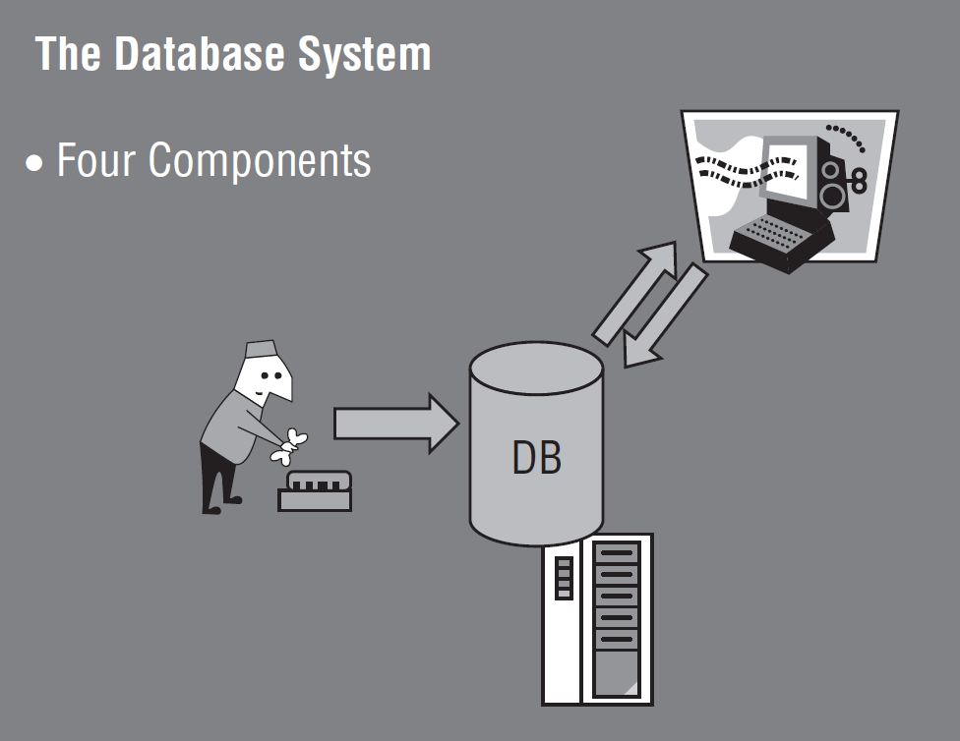
The Database System
Server environment
Maintenance jobs
The client application
The database

Slide 8
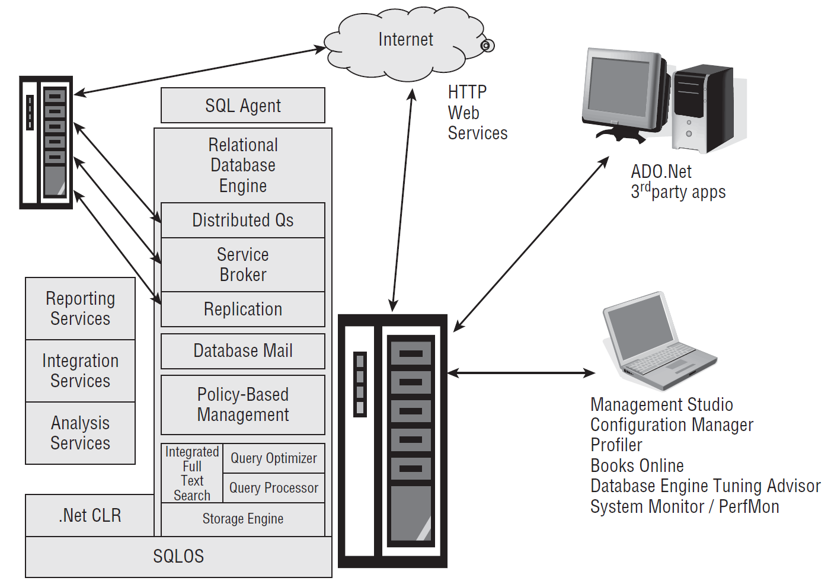
SQL Server

Slide 9


Slide 10
1. Create a SQL Database
A SQL database contains multiple objects such as tables, views, stored procedures, functions, indexes, triggers.

Slide 11
Database Schemas
https://blog.quest.com/using-database-schemas-in-sql-server/
In a relational database management system such as SQL Server, the database contains various objects. These can be tables, stored procedures, views and functions.
In a database, the schema refers to the logical collection of database objects.
You can use schemas to segregate objects depending on the application, access rights and security.

Slide 12
Built-in Logical Schemas
SQL Server provides the following built-in logical schemas:
dbo
sys
guest
INFORMATION_SCHEMA
Every SQL Server schema must have a database user as a schema owner. The schema owner has full control over the schema. You can also change the schema owner or move objects from one schema to another.

Slide 13
2. Show all Schemas
SELECT s.name AS schema_name,
u.name AS schema_owner
FROM sys.schemas s
INNER JOIN sys.sysusers u ON u.uid = s.principal_id
ORDER BY s.name;

Slide 14
3. Create a Schema
CREATE SCHEMA hr AUTHORIZATION dbo;
GO
CREATE SCHEMA admin AUTHORIZATION dbo;
GO
CREATE TABLE hr.Users (
ID int identity(1,1) PRIMARY KEY,
[Name] varchar(100)
)
CREATE TABLE [admin].Users (
ID int identity(1,1) PRIMARY KEY,
[Name] varchar(100)
)
GO

Slide 15
Database Roles
https://www.mssqltips.com/sqlservertip/1900/understanding-sql-server-fixed-database-roles/
Within each database, SQL Server does have fixed database roles, ones which are standard and included in every database.
These differ from the database roles you can create and use yourself in that they have pre-assigned permissions.
The fixed database roles are:
db_owner
db_securityadmin
db_accessadmin
db_backupoperator
db_ddladmin
db_datareader
db_datawriter
db_denydatareader
db_denydatawriter

Slide 16
db_owner role
A member of the db_owner role can do anything inside the database.
Now there is a difference between a member of the db_owner role and the dbo user.
That difference is that if someone maps into the database as the dbo user, that person bypasses all security checks.
If a user is not dbo but is a member of the db_owner role, it does receive a security check.

Slide 17
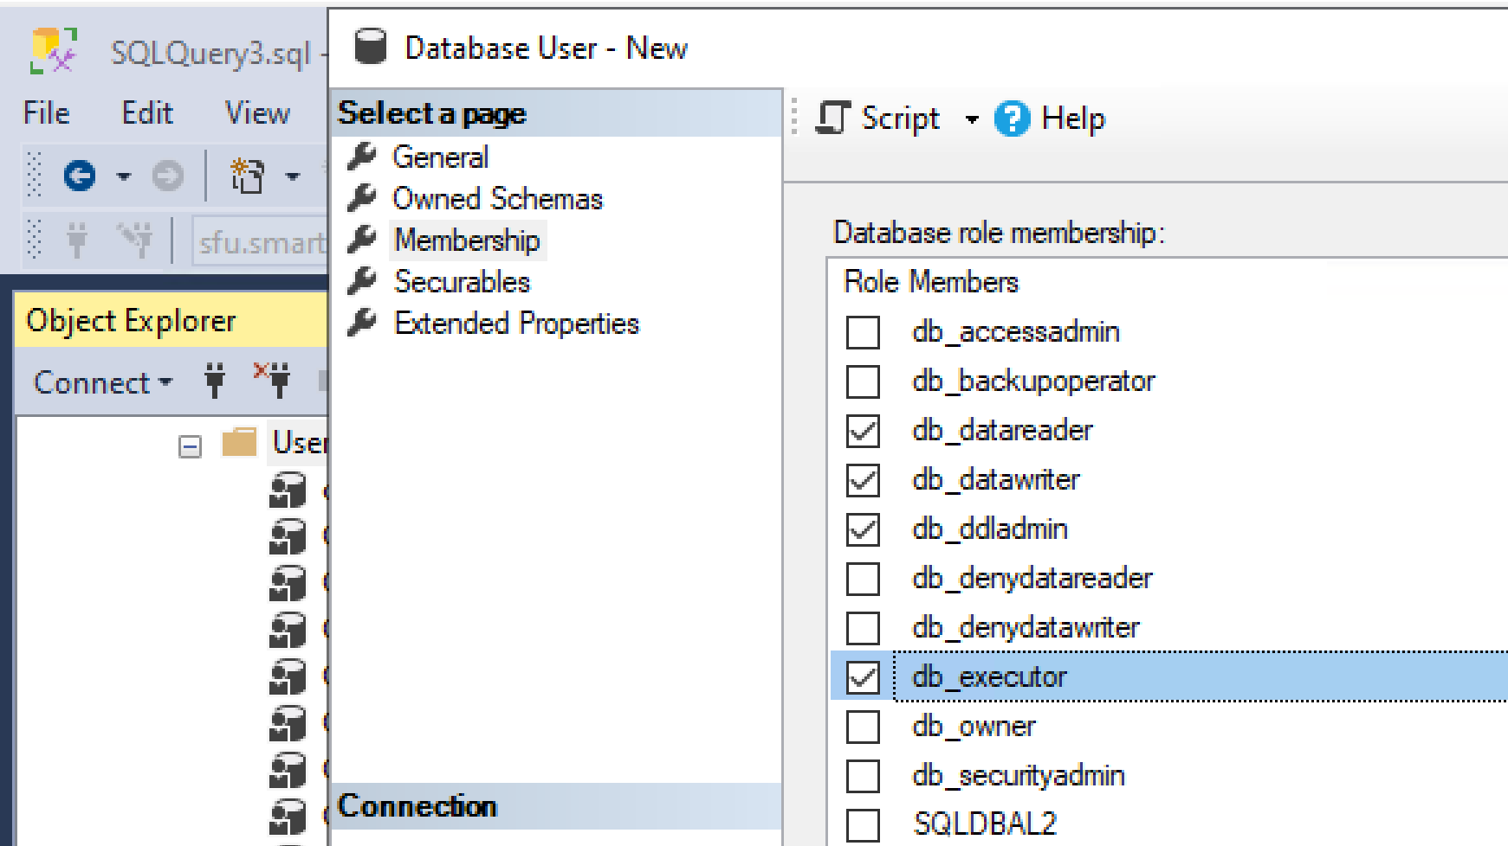
db_executor role
GRANT EXECUTE TO [sfu.smartstatus.com];
GO

Slide 19
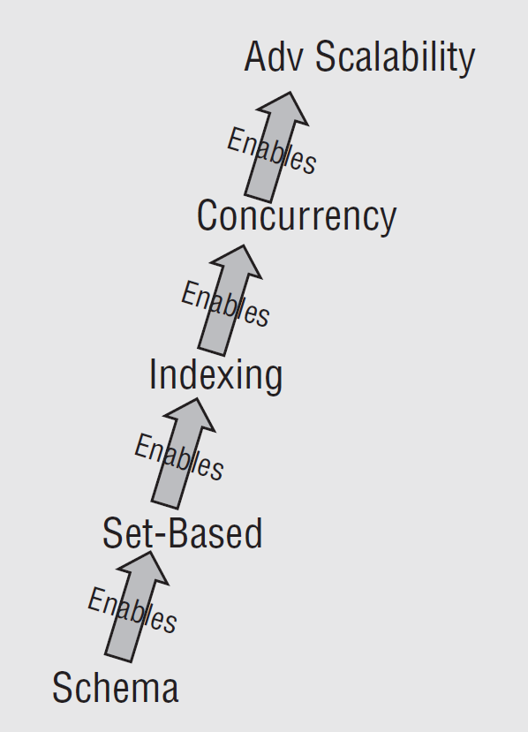
Smart Database Design
My career has focused on turning around database projects that were previously considered failures and recommending solutions for ISV databases that are performing poorly.
In nearly every case, the root cause of the failure was the database design.
It was too complex, too clumsy, or just plain inadequate.

Slide 20
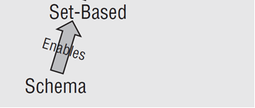
Physical Schema
The physical schema includes the database’s tables, columns, primary and foreign keys, and constraints. Basically, the "physical" schema is what the server creates when you run data definition language (DDL) commands.
A poorly designed (either non-normalized or overly complex) physical schema encourages developers to write iterative code, code that uses temporary buckets to manipulate data, or code that will be difficult to debug or maintain.
Designing an elegant database schema is the first step in maximizing the performance of the overall database system, while reducing costs.

Slide 21
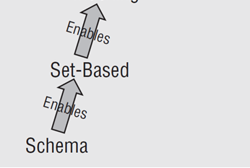
Set-Based Queries
SQL Server is designed to handle data in sets.
SQL is a declarative language, meaning that the SQL query describes the problem, and the Query Optimizer generates an execution plan to resolve the problem as a set.
Iterative T-SQL code, typically implemented via cursors, forces the database engine to perform thousands of wasteful single-row operations, instead of handling the problem in one larger, more efficient set.

Slide 22
Indexing
An index is an organized pointer used to locate information in a larger collection.
An index is only useful when it matches the needs of a question.
In this case, it becomes the shortcut between a question and the right answer.
The key is to design the fewest number of shortcuts between the right questions and the right answers.

Slide 23

Thank You & See You Again

